Slide 1


Information and Technology

Slide 2
CV
My name is Bold-Erdene.
Born in 1998.
Graduated from high school in 2016.
In 2023, he started studying programming at University of Mandakh.

Slide 3
The basic concepts in information technology
Information security
Software
Hardware
Database
Network management

Slide 4

Information security
The term 'information security' means protecting information and information systems from unauthorized access, use, disclosure, disruption, modification, or destruction in order to provide integrity, confidentiality, and availability.

Slide 5
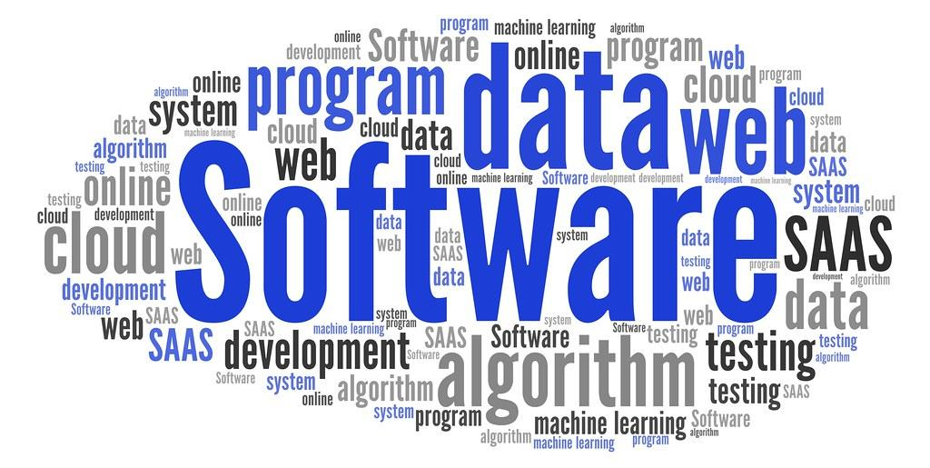
Software
Software is a set of instructions, data or programs used to operate computers and execute specific tasks.

Slide 6
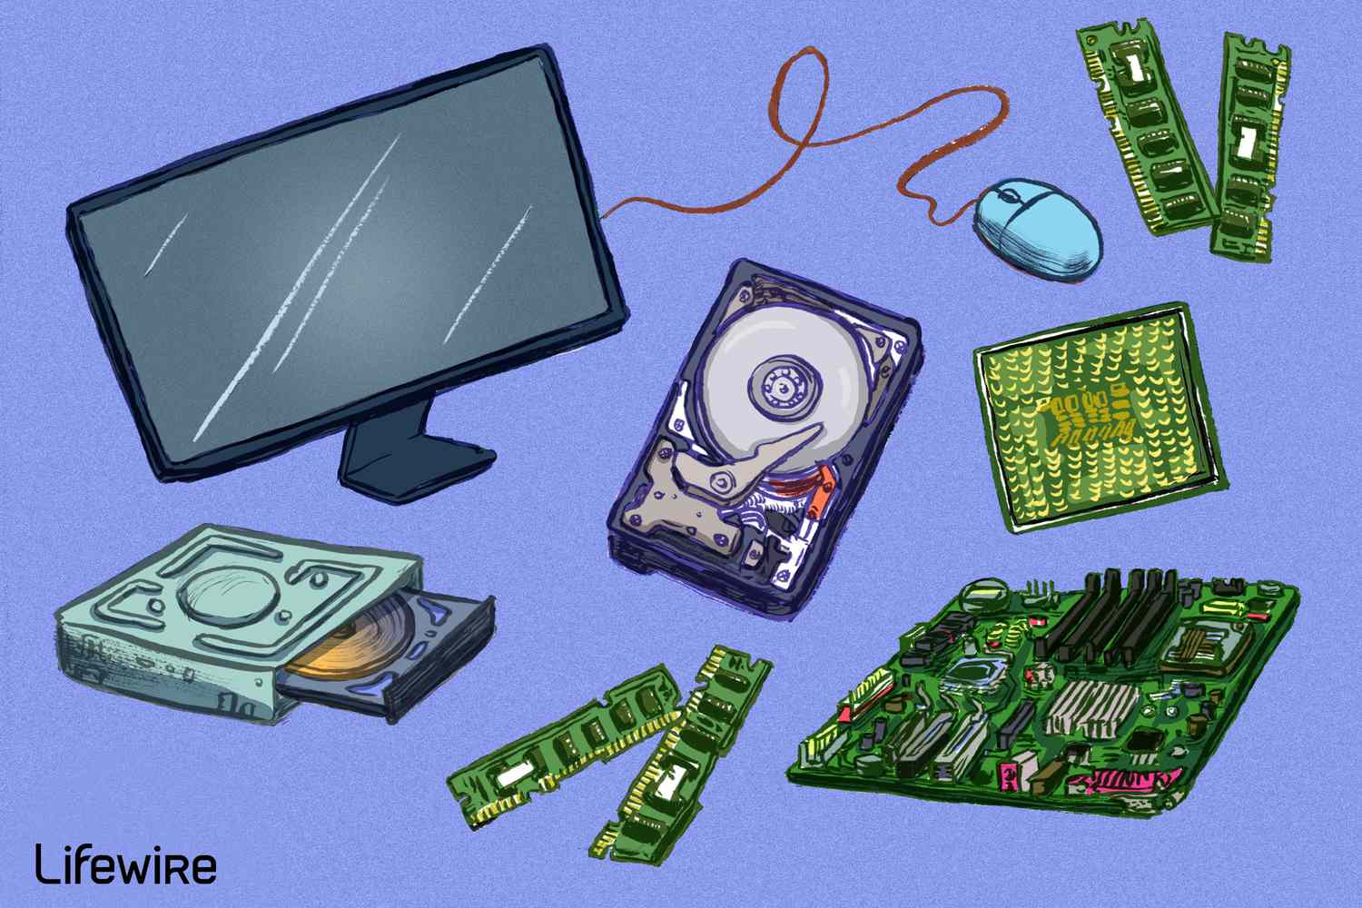
Hardware
Hardware refers to the external and internal devices and equipment that enable you to perform major functions such as input, output, storage, communication, processing, and more.

Slide 7
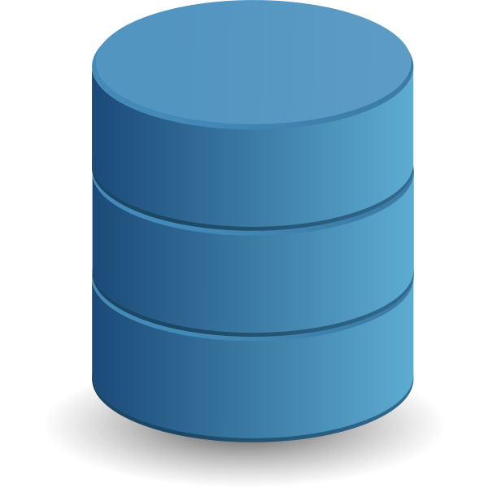
Database
A database is an organized collection of structured information, or data, typically stored electronically in a computer system. A database is usually controlled by a database management system (DBMS).

Slide 8
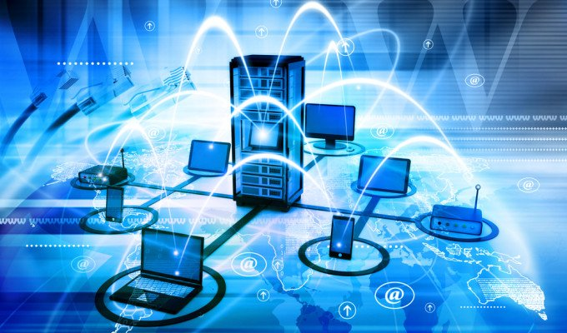
Network management
Network management is the sum total of applications, tools and processes used to provision, operate, maintain, administer and secure network infrastructure.

Slide 9
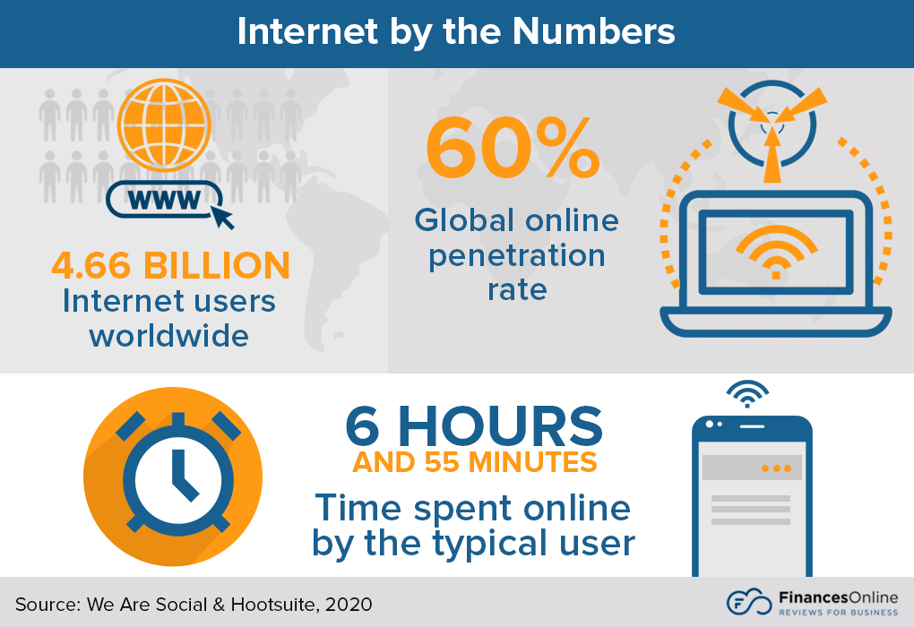
Internet by the Numbers

Slide 10
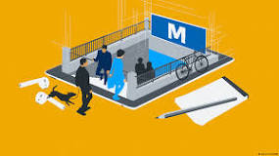
Future of Information technology
People will soon stroll virtually through a three-dimensional version of the internet dubbed the "metaverse"

Slide 11
Sources
https://www.google.com/
https://en.wikipedia.org/wiki/Information_technology
Information technology book by Virginia Evans, Jenny Dooley, Stanley Wright.

